Slide 1

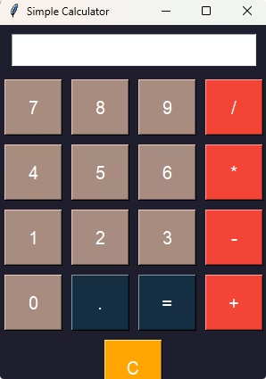
Nexthikes Project
Exploring Simple Calculator
Project Timeline: April 2025 - 8th May 2025
Presented By:- PRADEEP KUMAR SINGH

Slide 2
Setting Up the Environment
Installation
Window
First, ensure VSCODE and Python is installed. Use pip install tkinter to get Tkinter.
Create the main window: root = tk.Tk(). Set the title: root.title("Simple Calculator").
Import
Then, import the Tkinter library with import tkinter as tk.

Slide 3




Implementing Button Functionality
Number Click
Define number_click(number) to append digits to display.
Operator Click
Create operator_click(operator) to handle operations.
Equals Click
Use equals_click() with eval() to calculate.

Slide 4
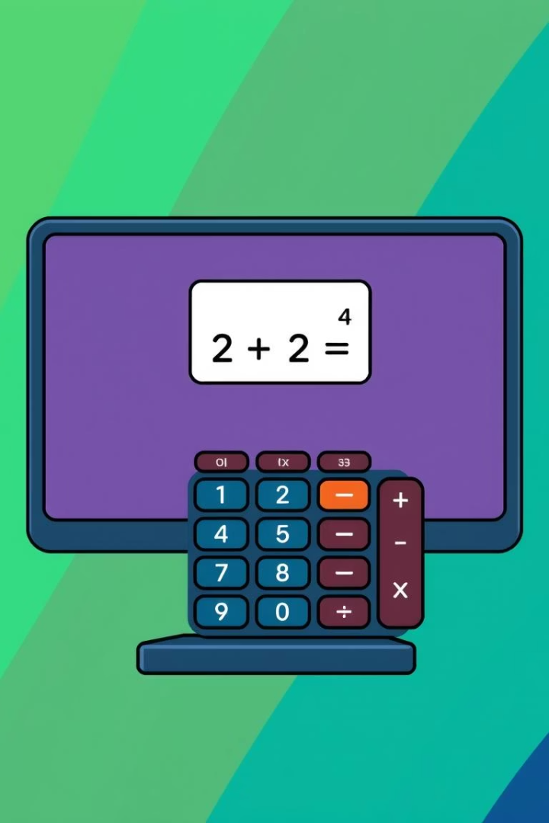
Designing the Calculator Layout
1
Display Area
2
Define Buttons
Create an Entry widget: display = tk.Entry(root). Use display.grid().
Make buttons for numbers, operators, equals, and clear.
3
Grid Layout
Use the grid layout manager to place buttons in rows and columns.

Slide 5



Testing and Error Handling
Error Messages
1
Display helpful error messages in the display area.
Try-Except
2
Implement error handling with try-except.
Test Cases
3
Test with various inputs to catch exceptions.

Slide 6



Application Used:-
Improve UI
Change colors, fonts, and button sizes.
Package App
Make it standalone with VSCODE.

Slide 7
References
1) Pw3schools.com - Exploring and Understanding Python Codes
2) www.color-hex.com - For Color Codes

